Slide 1
ELECTRICITY PRICES PREDECTION USING
MECHINE LEARNING
Phase-2 project
Team member
S.Dinesh kumar(411521104030)
J.Deepak (411521104017)
S.Karthi (411521104051)
K.Deepan chakkaravarthi(411521104020)

Slide 2
INTRODUCTION:
The price of electricity depends on many factors. Predicting the price of electricity helps many businesses understand how much electricity they have to pay each year. The Electricity Price Prediction task is based on a case study where you need to predict the daily price of electricity based on the daily consumption of heavy machinery used by businesses. So if you want to learn how to predict the price of electricity, then this article is for you. In this article, I will walk you through the task of electricity price prediction with machine learning using Python.
The ability to accurately forecast electricity prices holds immense value. By leveraging advanced algorithms and historical data, these powerful technologies unlock the potential to predict price fluctuations and optimize energy consumption. From enabling efficient resource allocation to aiding market participants in making informed decisions, the integration of data science and machine learning revolutionizes the electricity industry with unprecedented insights and foresight.
we delve into the realm of data science to forecast electricity prices with utmost precision. With the transformative power of advanced algorithms and predictive modeling, we aim to uncover underlying patterns and trends that shape the volatile realm of electricity markets. Join us as we explore the intricacies of this crucial field and reveal the potential of data-driven insights in anticipating price fluctuations.

Slide 3
IMPORTANCE OF FORECASTING ELECTRICITY PRICES
Accurate forecasting of electricity prices is of utmost importance for various stakeholders, including energy producers, consumers, and policymakers. By understanding and predicting price fluctuations, businesses can optimize their energy procurement strategies, consumers can make informed decisions about their energy consumption, and policymakers can implement effective regulations. In this section, we will explore the significance of forecasting electricity prices and the potential benefits it offers to different industry players.
FORECASTING USING DATA SCIENCE
Data science plays a crucial role in electricity price forecasting. It allows us to analyze vast amounts of historical data and identify patterns, trends, and factors that influence price fluctuations. By applying advanced statistical models and machine learning algorithms, we can make accurate predictions, enabling energy companies, policymakers, and consumers to make informed decisions and optimize their energy usage and budgeting strategies.
Case Study:
Suppose that your business relies on computing services where the power consumed by your machines varies throughout the day. You do not know the actual cost of the electricity consumed by the machines throughout the day, but the organization has provided you with historical data of the price of the electricity consumed by the machines. the information of the data we have for the task of forecasting electricity prices are DateTime, Holiday , Holiday Flag , Day Of Week , Week Of Year , Day , Month , Year, Period Of Day ect

Slide 4
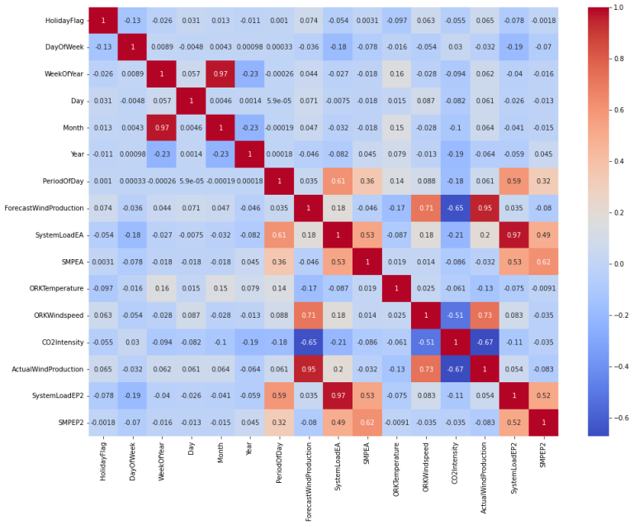
METHOD:
Data collection and preprocessing
Accurate forecasting starts with comprehensive data collection and preprocessing. This involves gathering historical electricity price data, as well as relevant factors such as weather conditions, economic indicators, and energy supply. The collected data then undergoes cleaning, normalization, and feature engineering to ensure it is suitable for analysis.. This involves gathering historical price data from reliable sources, cleaning and organizing the data, handling missing values or outliers, and transforming the data into a suitable format for analysis.

Slide 5
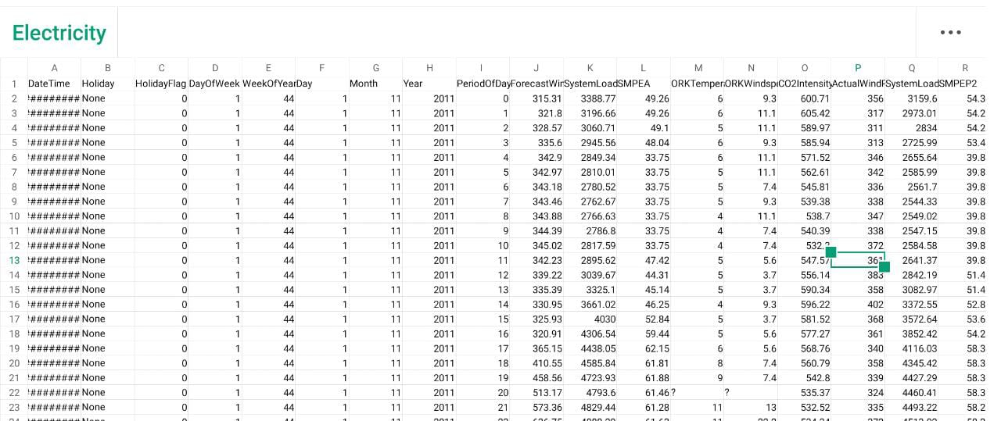
DATA SET:

Slide 6
Exploratory data analysis
Exploratory data analysis is a crucial step in forecasting electricity prices. It involves examining the dataset to understand the patterns, trends, and relationships between variables. This analysis helps identify outliers, missing values, and correlations that can impact the accuracy of the forecasting models. By gaining insights from the data, data scientists can make informed decisions about the appropriate modeling techniques and adjustments needed for accurate and reliable electricity price forecasting.
Choosing the appropriate forecasting model
Choosing the appropriate forecasting model is a critical step in accurately predicting electricity prices. Data scientists must consider factors such as seasonality, trend, and volatility to select the most suitable model, such as ARIMA, SARIMA, or regression-based models. The chosen model should capture the inherent characteristics of the data, leading to accurate and reliable electricity price forecasts.
Training and testing the model
After selecting the appropriate forecasting model, the next step is to train and test the model using historical electricity price data. This process involves dividing the data into training and testing sets, fitting the model to the training set, and evaluating its performance on the testing set. By accurately training and testing the model, data scientists can ensure the reliability and accuracy of their electricity price forecasts.

Slide 7
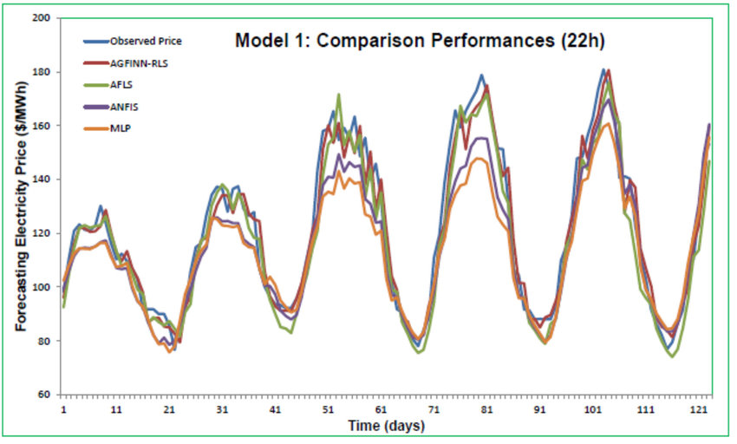
Evaluating the model performance
To evaluate the performance of the electricity price forecasting model, several metrics can be used, such as mean absolute error (MAE), root mean square error (RMSE), and mean absolute percentage error (MAPE). These metrics measure the deviation between the actual and predicted prices and provide insights into the model's accuracy. By analyzing these performance measures, data scientists can fine-tune the model and enhance its forecasting capabilities. High-performing models can provide valuable insights and help stakeholders make better decisions in the unpredictable electricity market.

Slide 8
Incorporating external factors in the forecasting models
Incorporating external factors in forecasting models allows for a more comprehensive and accurate prediction of electricity prices. Factors such as weather conditions, economic indicators, and energy demand can significantly impact prices. By considering these external variables, data scientists can enhance the forecasting models and provide stakeholders with more reliable insights for decision making in the volatile electricity market.
Challenges and limitations in electricity price forecasting
While incorporating external factors improves electricity price forecasting, there are still challenges and limitations. Accurate weather data availability, economic uncertainties, and unpredictable events like natural disasters can impact model accuracy. Additionally, data quality and availability pose challenges. It is important for data scientists to continuously improve models, address limitations, and refine methodologies to ensure reliable and robust electricity price forecasts.
Implementing the forecasting model in real-time
After fine-tuning the forecasting model, it can be implemented in real-time. This allows for continuous monitoring and updating of electricity price predictions based on new data. Data science and machine learning have revolutionized electricity price forecasting. These techniques have been successfully applied in various industries such as energy trading, risk management, and grid optimization. By analyzing historical data, weather patterns, economic indicators, and other relevant factors, data scientists can develop accurate models that help businesses make informed decisions about electricity procurement, pricing strategies, and resource allocation.

Slide 9
Conclusion
In conclusion, the data science techniques used for forecasting electricity prices have shown significant potential in providing accurate information for stakeholders. However, there is still room for further research
to refine the models and improve their performance. Future studies could focus on incorporating additional factors, such as weather patterns and renewable energy generation, to enhance the accuracy of the forecasts and enable even more informed decision-making. TCN models are computationally efficient to use for long input sequences when fully trained and more efficient than LSTM models. The results indicate that it is possible to
use machine learning forecasting to optimize electricity hedging via future contracts. The bestperforming model
for hedging strategies, given the data and models evaluated in this project, is based on TCN. This project presents two multivariate machine learning models for predictingthe electricity price via future contracts for two Swedish bidding areas.

